Slide 1
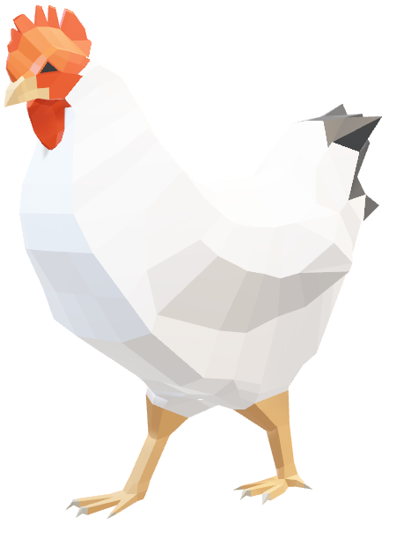
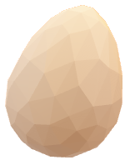
EGG DROP LAB
1
Notes:
Title slide, do whatever

Slide 2
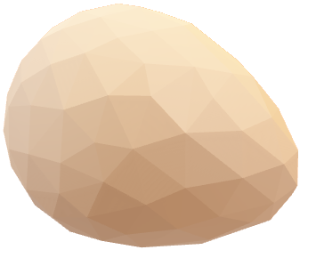
Tasked with designing, building, and testing a structure that will allow a raw egg to fall on a hard surface without cracking or breaking, we decided to attempt to maximize the impact time and divert the force to minimize the instantaneous force applied to the egg while still maintaining the same impulse.
GOAL
2
Notes:
So, you all know the problem: save an egg from a fall without the surface cracking or breaking.
To do this, we decided to maximize the impact time and try to direct the impact force away from the egg itself.

Slide 3
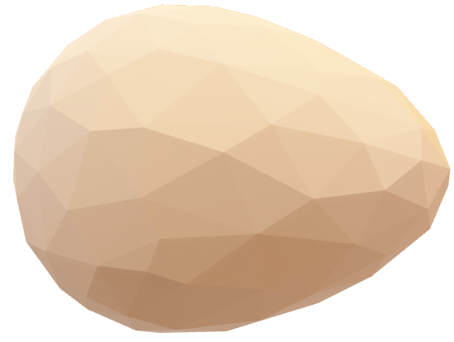
As the structure increases in mass, the velocity at impact remains the same, but the momentum will increase; the mass of the whole system must be accounted for.
The average egg can only withstand 35N of horizontal force, an egg without structure will have a momentum of 0.27 kg*m/s.
Air resistance can be considered.
J = F*Δt; Maximizing the impact time will minimize the instantaneous force.
FACTORS/
PRINCIPLES
3
Notes:
We faced a few challenges.
First, every piece that you add to your structure trades off mass for cushioning, this added momentum has to be dealt with somehow.
Second, none of the materials were allowed to be glued to the egg, rubber banding to the egg was allowed but the force of the tension complicated things.
And the biggest challenge, we couldn’t test our structure before the drop day.

Slide 4
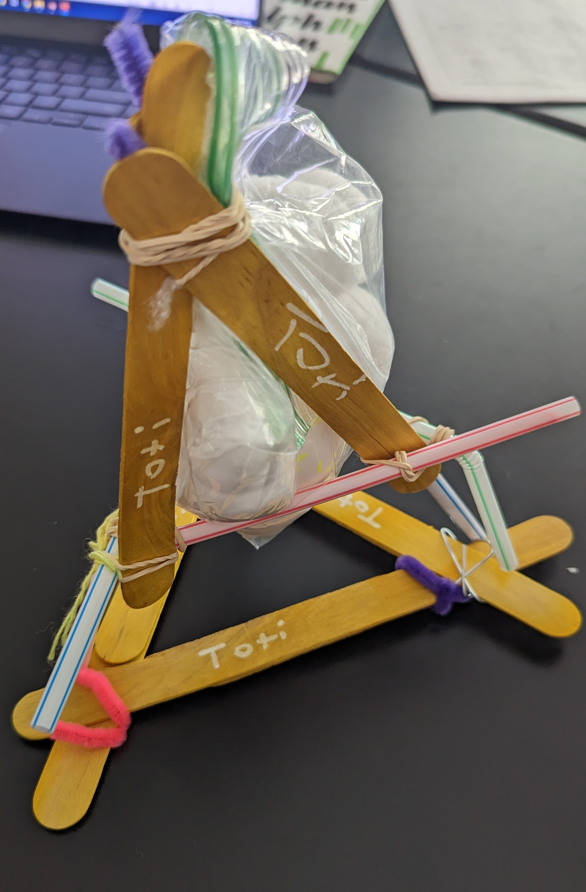
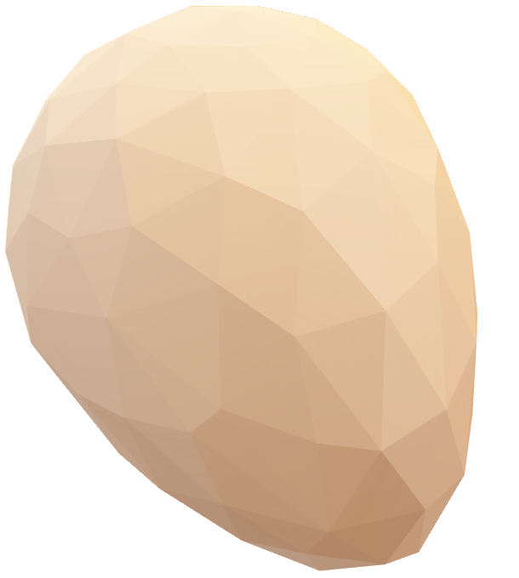
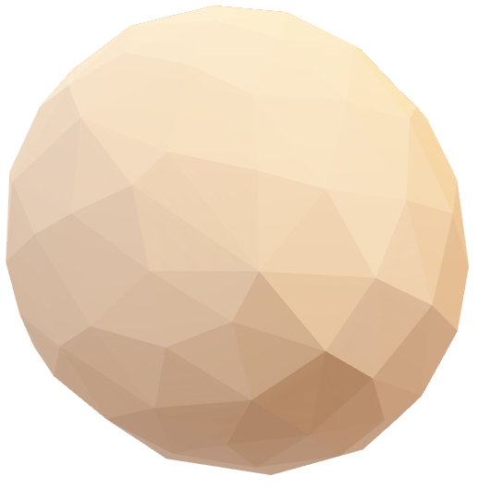
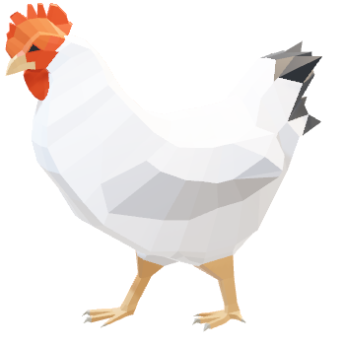
DESIGN
4

Slide 5

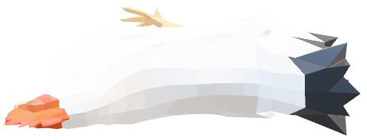

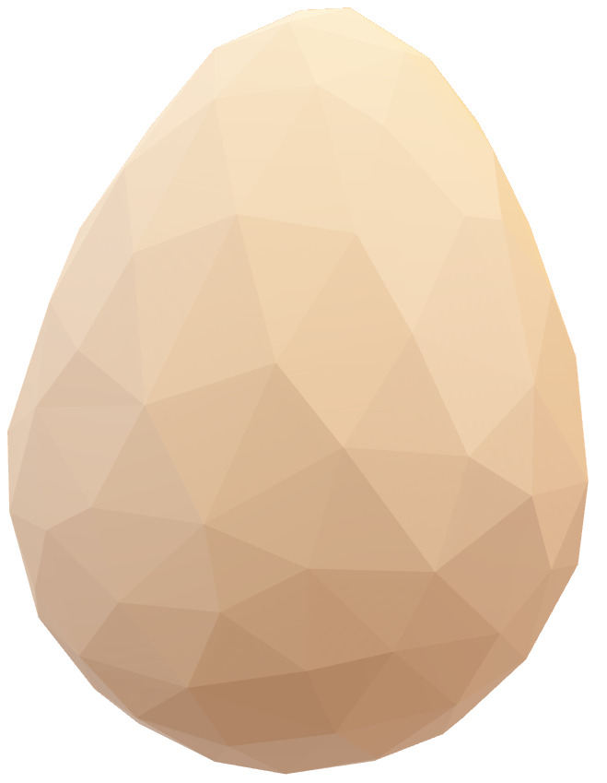
Our egg survived drops of one and two meters and shattered at a drop of three meters. The structure suffered minor damages after the first drop, however these were easily repairable.
RESULTS
5

Slide 6
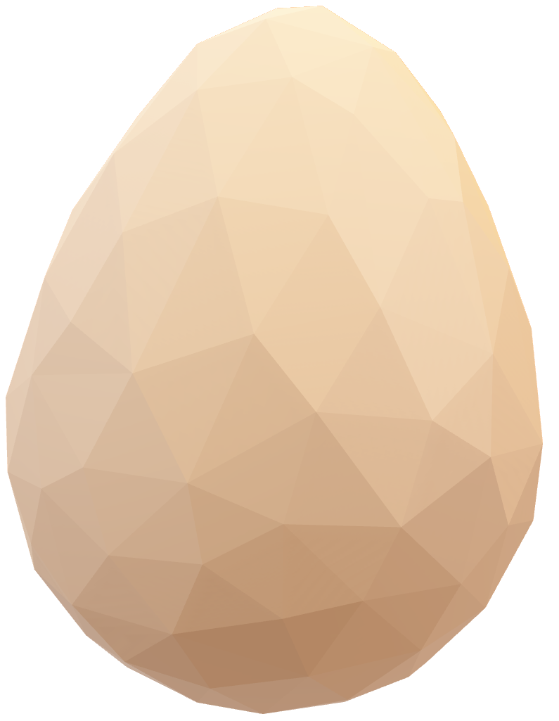
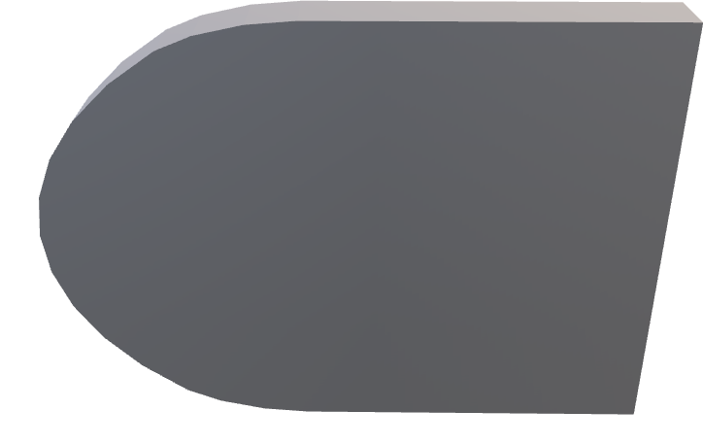
We didn’t account for weight optimization. The structure landed on its side, exposing the egg’s weak points. We could also improve the weight distribution by keeping the bottom of the structure grounded with extra weight and lightening up the load on the top of the structure where the egg is. We could do this by attaching paper clips to the bottom of the structure and moving the egg and cotton ball bag to the bottom of the structure.
IMPROVEMENTS
6

Slide 7
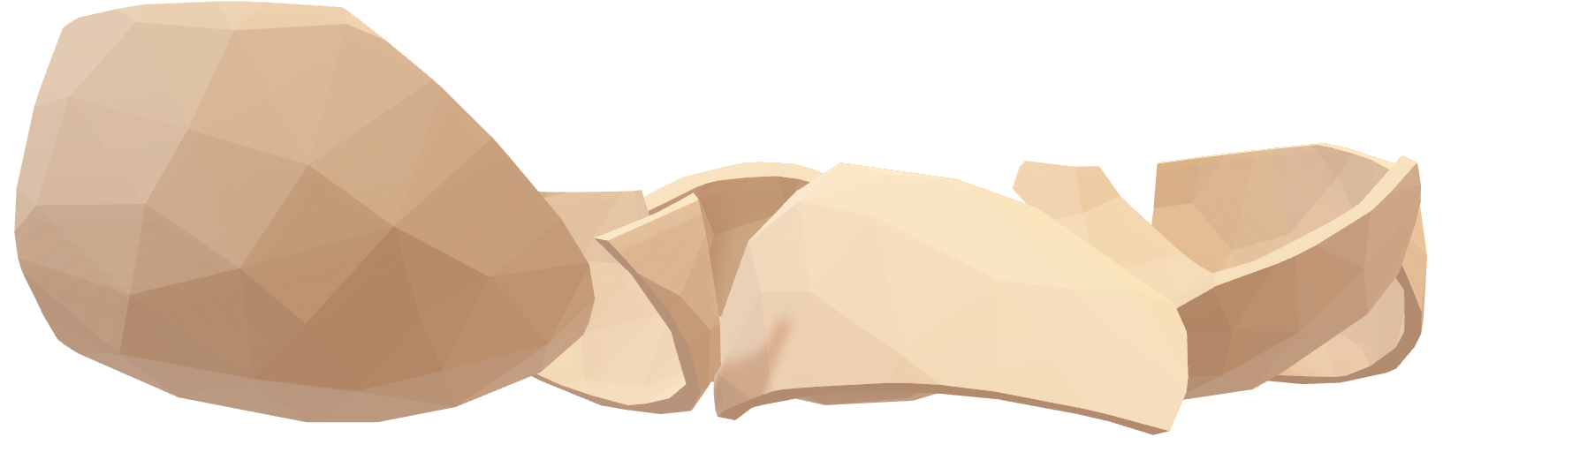
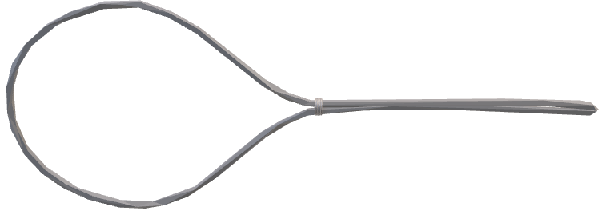
END

